Slide 1
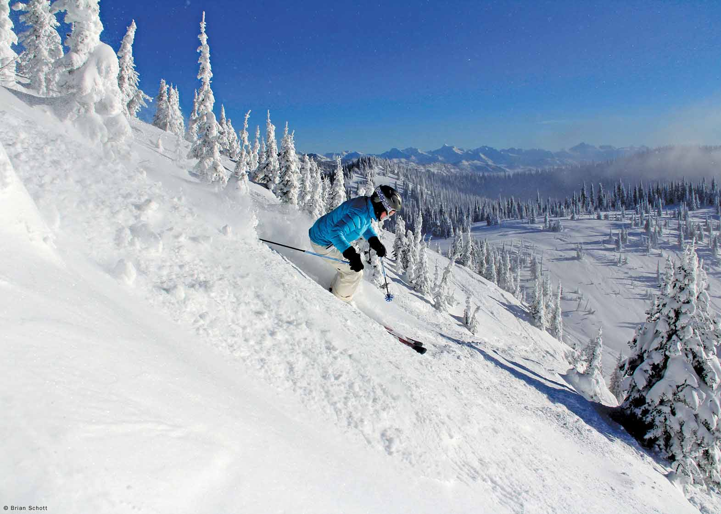
Blue Mountain Resort

Slide 2
Problem
Create a new data-based pricing strategy to offset the increase of 1,540,000 for installing new chair lift
by either cutting costs
increasing ticket price

Slide 3
Key features - features people look for
Regression Model Results
Currently – Big mountain’s key features
Vertical drop
Snow Making
Total chairs
Fast Quads
Number of Runs
Longest run mi
Trams
Skiableterrain_ac
vertical drop doing well- but there are still quite a few resorts with a greater drop
very high up the league table of snow making area as well.
Big Mountain has 3 fast quads

Slide 4
Features to enhance
Add a run and increase the vertical drop by 150 feet and install an additional chair lift
This scenario supports increasing the ticket price by $2

Slide 5
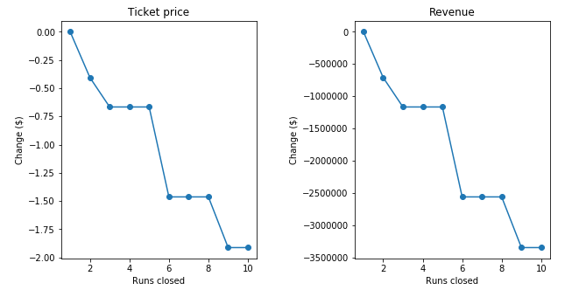
Cutting costs
From this data we can determine if we can close down up to 5 least used runs with minimal loss in ticket price.

Slide 6
Conclusion
Current modelling suggest a price increase to $95.87. Even with the expected mean absolute error of $10.39, this suggests there is room for an increase.
A $2 increase in ticket price, which given Big Mountain’s 350,000 annual visitors would result in approximately $700,000 in additional revenue.
Cut operating costs by closing upto 5 runs which are not as popular
increase the vertical drop by 150 feet of a run

